Slide 1


CUSTER CONTEXO GROUP
Better Insights · Better Decisions

Slide 2
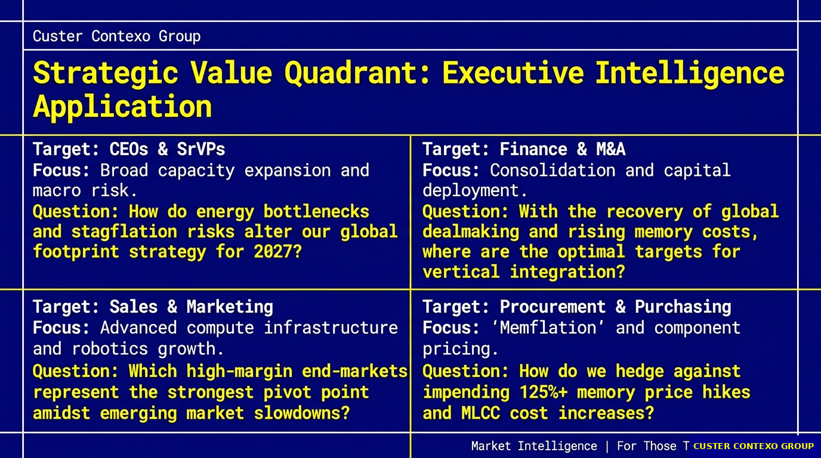

CUSTER CONTEXO GROUP
Better Insights · Better Decisions

Slide 3

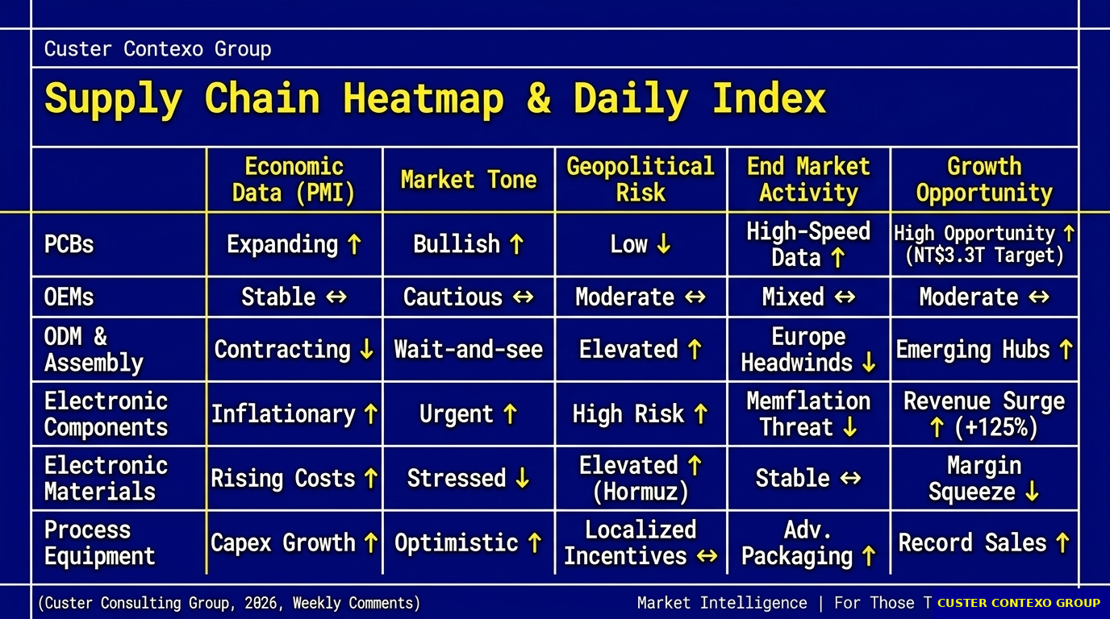
CUSTER CONTEXO GROUP
Better Insights · Better Decisions

Slide 4
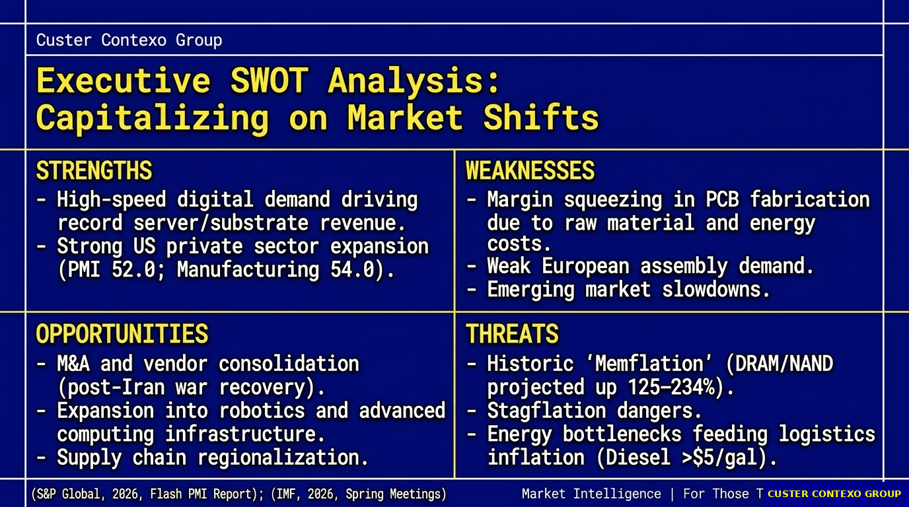
CUSTER CONTEXO GROUP
Better Insights · Better Decisions

Slide 5
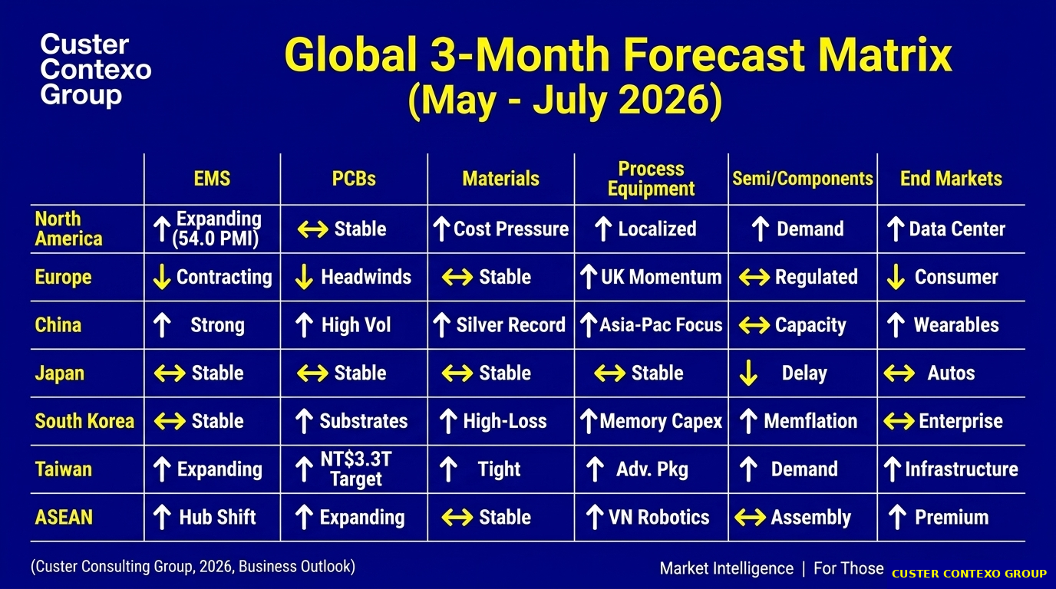
Better Insights · Better Decisions

Slide 6
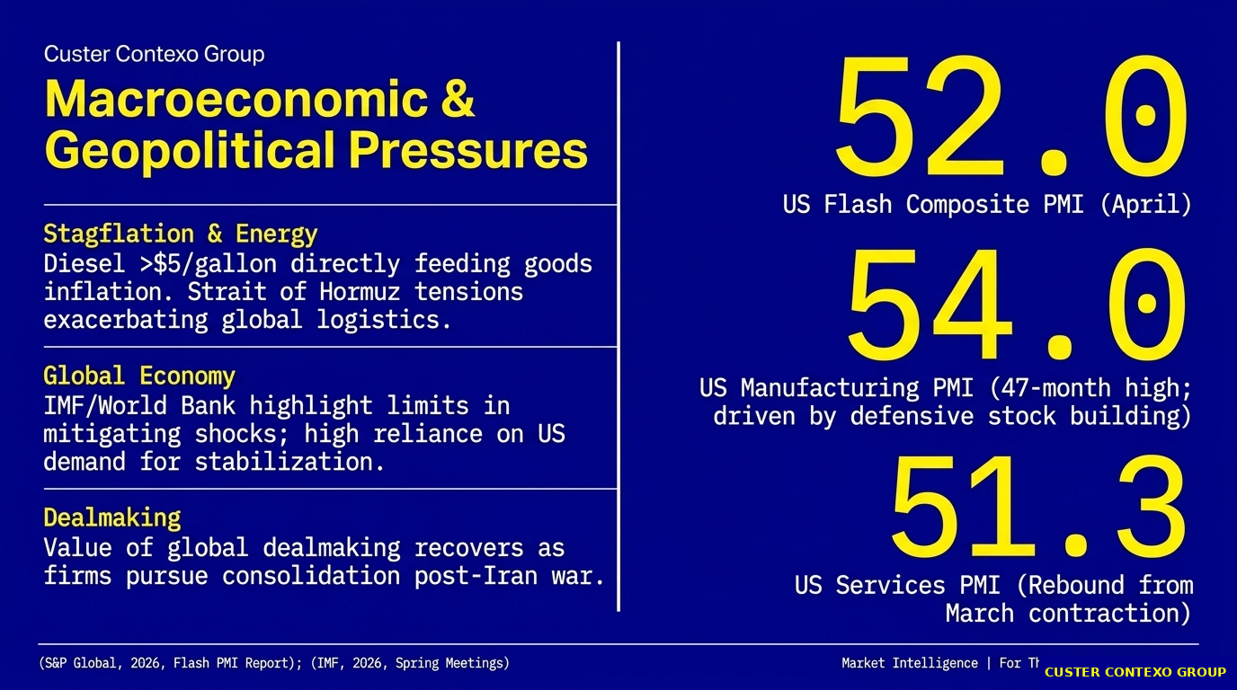
CUSTER CONTEXO GROUP
Better Insights · Better Decisions

Slide 7
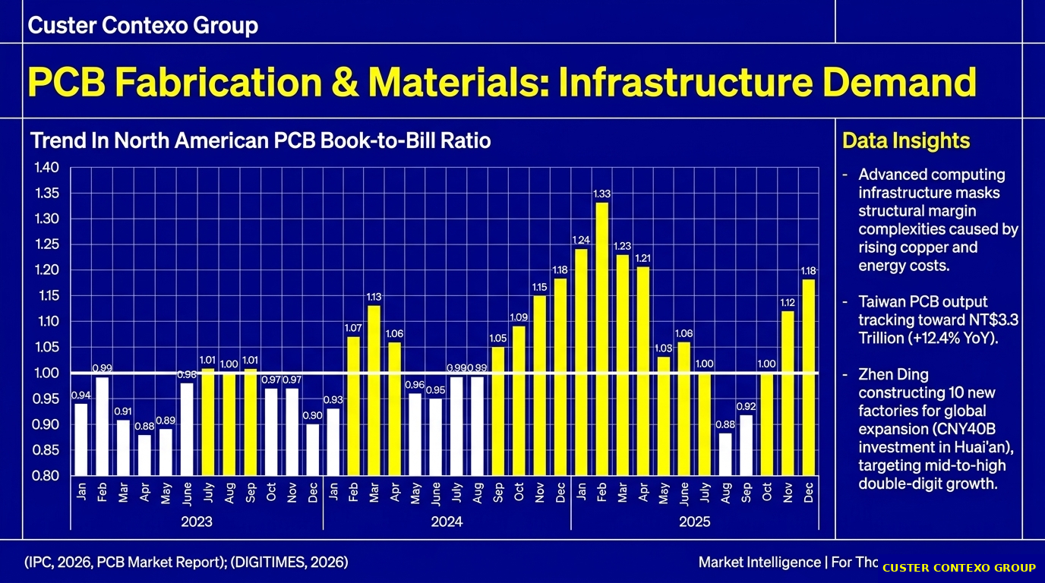
CUSTER CONTEXO GROUP
Better Insights · Better Decisions

Slide 8
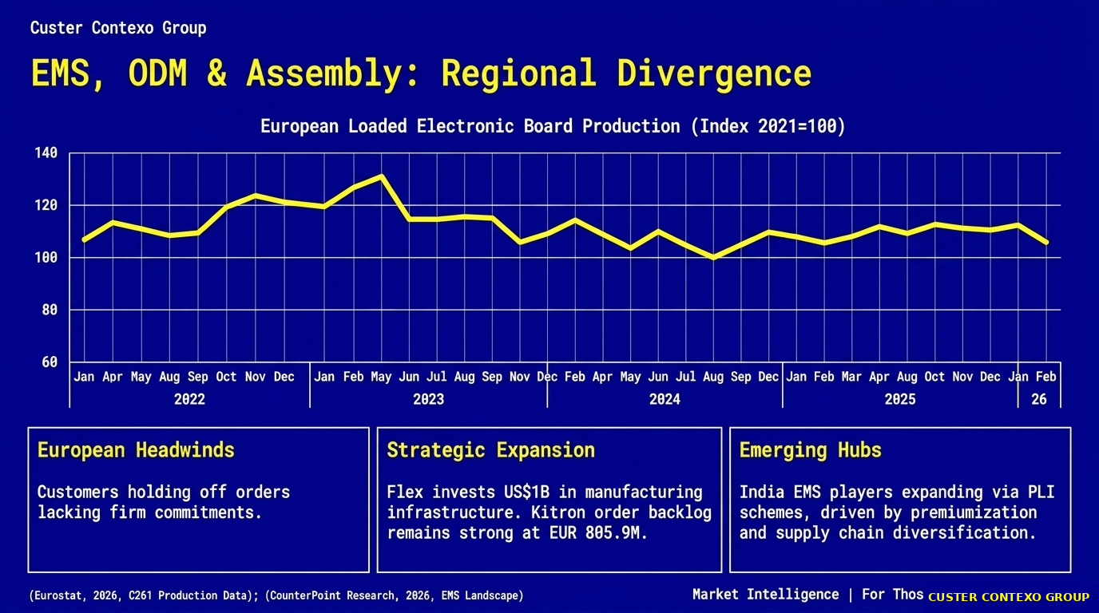
CUSTER CONTEXO GROUP
Better Insights · Better Decisions

Slide 9

CUSTER CONTEXO GROUP
Better Insights · Better Decisions

Slide 10
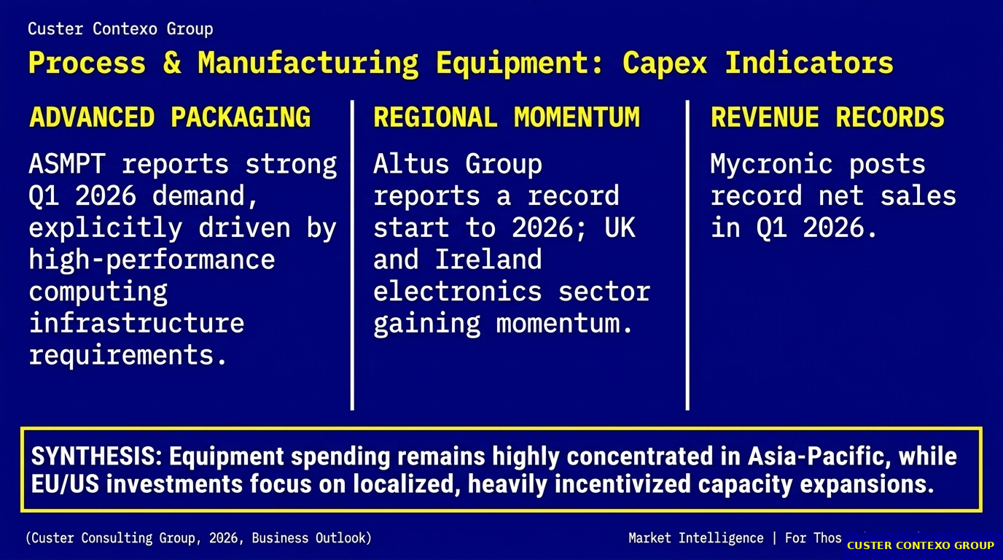
CUSTER CONTEXO GROUP
Better Insights · Better Decisions

Slide 11
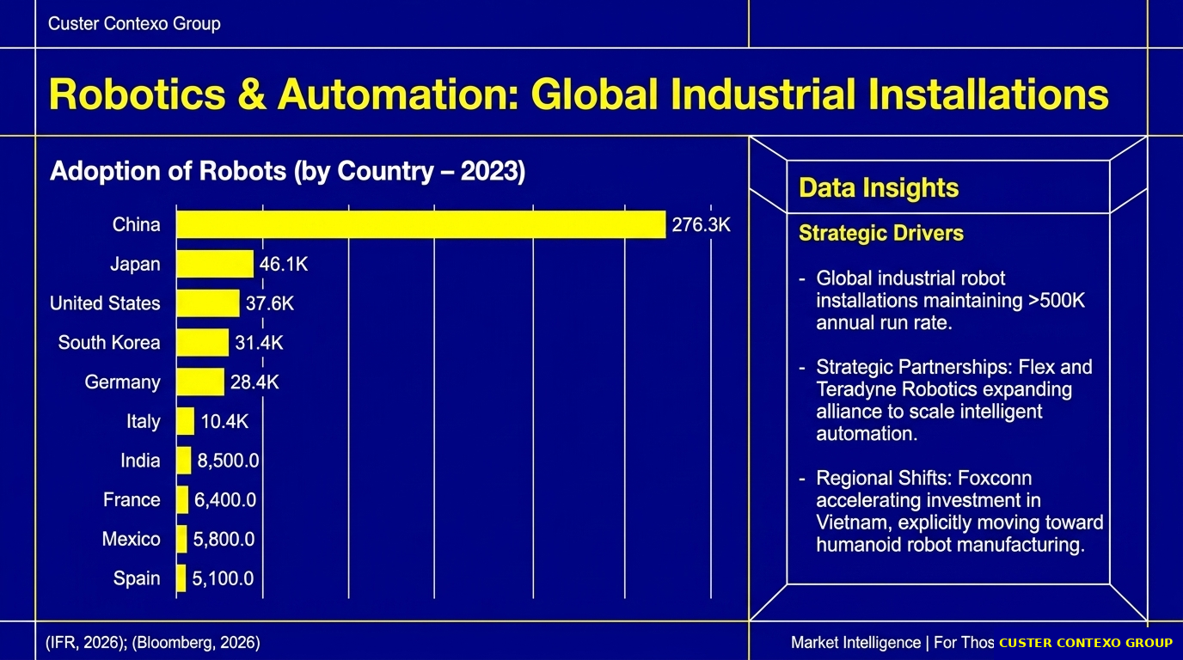
CUSTER CONTEXO GROUP
Better Insights · Better Decisions

Slide 12
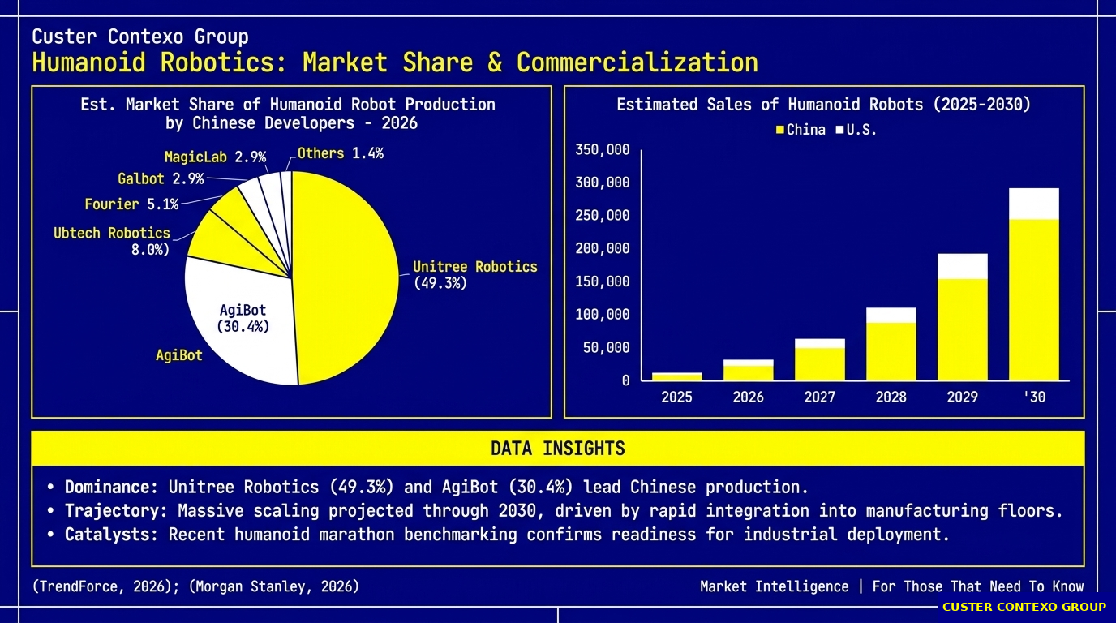
CUSTER CONTEXO GROUP
Better Insights · Better Decisions

Slide 13
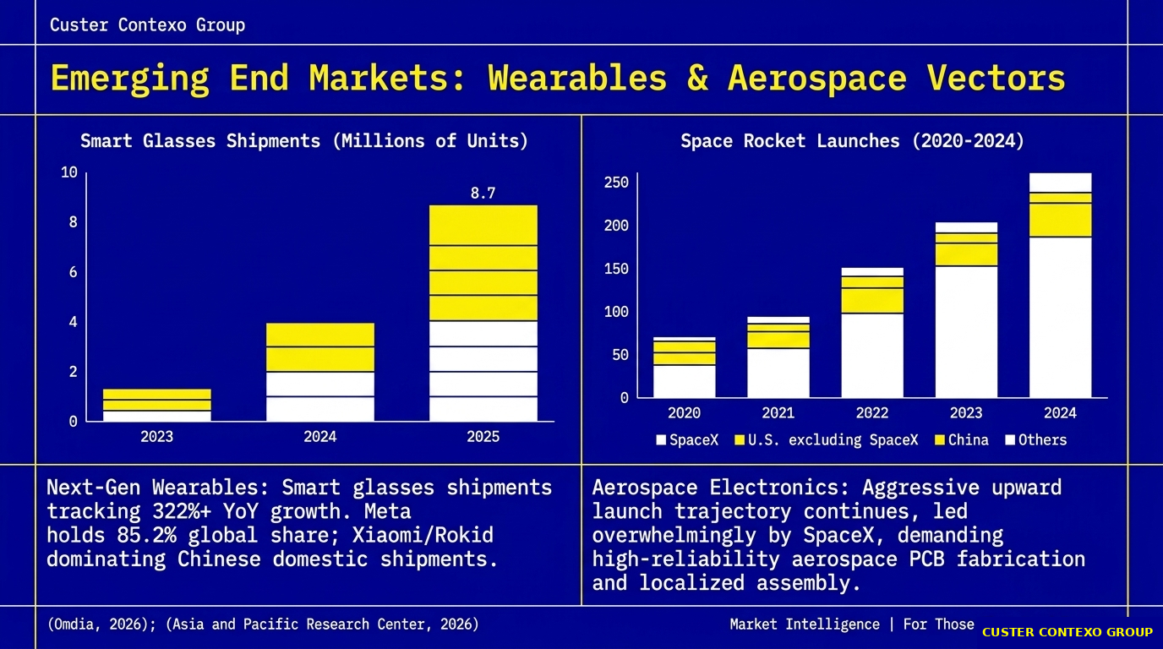
CUSTER CONTEXO GROUP
Better Insights · Better Decisions

Slide 14
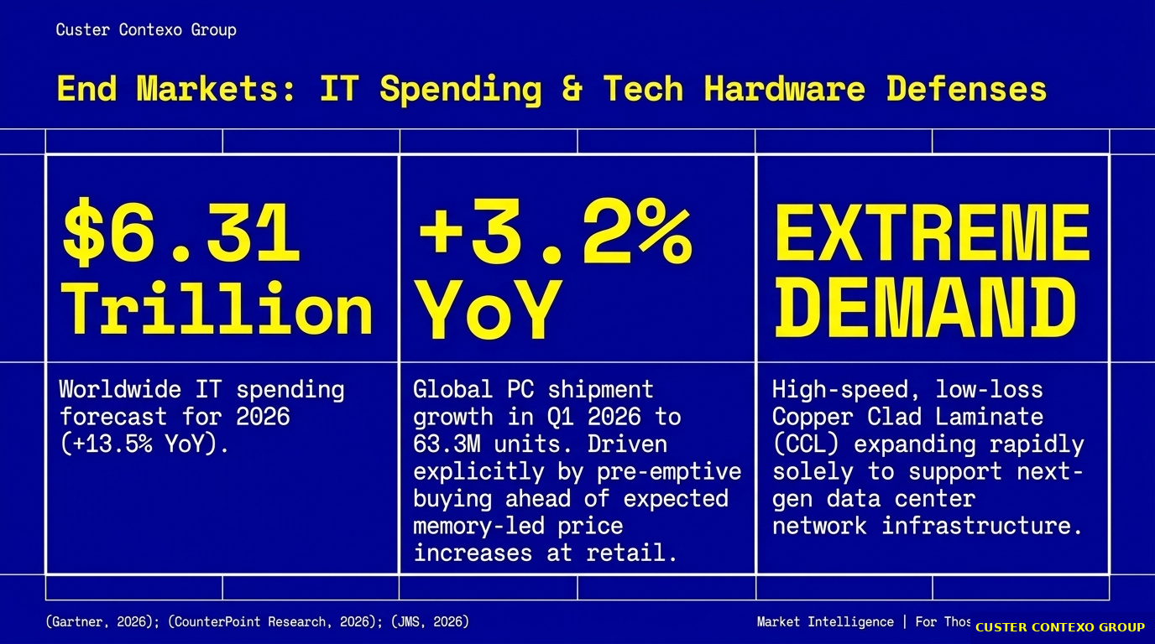
CUSTER CONTEXO GROUP
Better Insights · Better Decisions

Slide 15
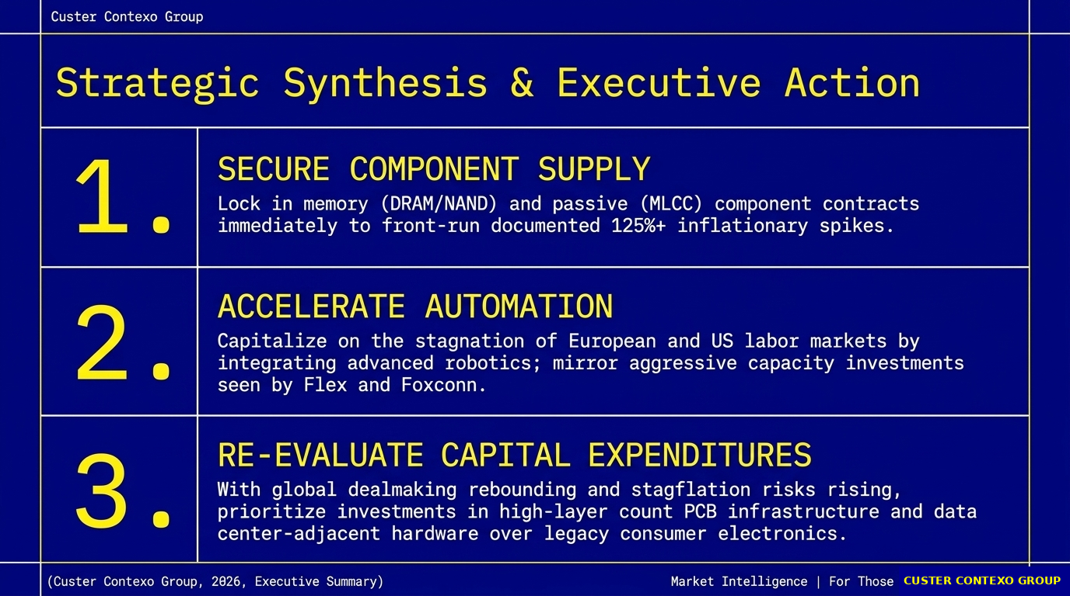
CUSTER CONTEXO GROUP
Better Insights · Better Decisions

