Slide 1

Contexo Supply Chain Market Pulse
Electronics Supply Chain
Week of July 25, 2026 · Daily News July 19–25
Jonathan Custer, CEO & President · Custer Contexo Group
Weekly Supply-Chain Intelligence · Charts & Notations Since 1999

Slide 2
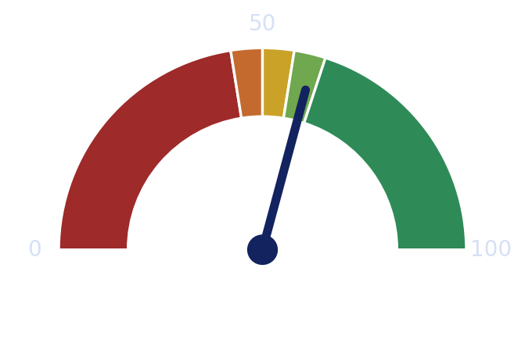



Contexo Supply-Chain Market Pulse
62.0 ▲ +1.2
53.1 ▲ +0.4
SECTOR HEALTH AVERAGE (w/w)
MONTHLY GLOBAL — Mild Expansion
Supply-Chain Tier Health (0–100, bar = level · number = week-over-week)
▲+0.4
▲+2.1
58.3 ▲ +1.3
▲+1.8
WHOLE-MARKET PULSE · Strong Expansion (w/w)
▲+2.4
▼0.6
▲+1.2
BOTTOM LINE
CENTRAL TENSION
AI-infrastructure capex redrew the hardware map at the board level this week — a real, broad expansion up the chain that stays narrow in end demand.
The whole chain is pulled by one vertical (AI). Bottom is in; slope is uneven; the risk is memory and substrate cost compressing margins before demand broadens.
Contexo Supply Chain Market Pulse · Weekly
custerconsulting.com · @joncustercontexo

Slide 3




The Week in One Picture — Macro Thread
$100+
+2.0%
~3%
Brent crude, peak Jul 23 (week of Jul 25)
US transport & warehouse PPI y/y (Jun, BLS)
OECD base-case global growth (Jun 2026)
+63.4%
Split
>2
Gartner AI platforms/models, 2026F ($64.3B)
Europe IP, May (Eurostat): FR firm, DE weak
STMicro book-to-bill, Q2 2026 reported
TAKEAWAY One thread ties the week: AI is the demand engine, Chinese overcapacity the competitive force, and cost has rotated from materials into energy, geopolitics and freight.
Contexo Supply Chain Market Pulse · Weekly
custerconsulting.com · @joncustercontexo

Slide 4




How the Supply-Chain Cogs Connect
Upstream capex decisions this week become downstream board and material commitments two quarters out — the whole chain is one connected system.
Process Equipment
▶
Electronic Materials
▶
Semiconductors
▶
PCB & Substrate
▶
EMS / ODM
▶
End Markets
Hyperscaler capex sets the pace
Memory, substrate, copper
Record billings; AI logic + HBM
NA b/b 1.60 (May); SE-Asia build
AI-server ODMs carry growth
AI datacenters pull demand
TAKEAWAY Read the chain end-to-end: hyperscaler capex today is the PCB and materials order book of 2027.
Contexo Supply Chain Market Pulse · Weekly
custerconsulting.com · @joncustercontexo

Slide 5

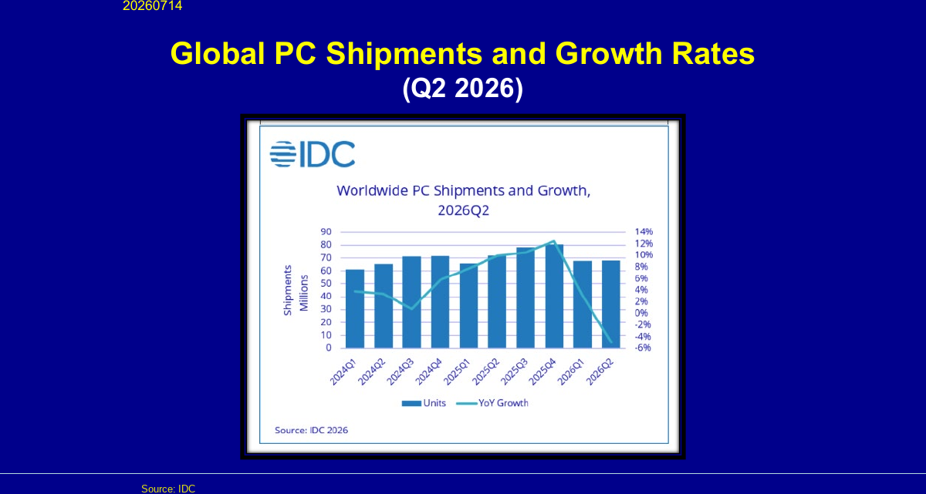
End Markets — Where the Demand Really Is
−4.9%
+24.1%
+63.4%
Global PC units, Q2 2026 (IDC)
India passenger vehicles, Jun (SIAM, 388K)
AI platforms & models, 2026F (Gartner)
ANALYST READ
DEMAND ▲
AI software and infrastructure demand is voracious (Gartner sees AI platforms up 63% to $64B) and defense electronics keep rising against a flat industrial backdrop.
SUPPLY ▼
End demand is narrow: Q2 PC shipments turned down as memory inflation reaches buyers, and mass-market handsets stay soft.
NAVIGATE →
Index capacity to the AI and high-reliability verticals that can absorb price; do not build for a consumer rebound the data does not yet show.
◆ CHART NOTE PCs fell for the first time this cycle as memory cost lands on the buyer — the AI pull has not yet broadened to consumer.
TAKEAWAY Demand is real but narrow — AI and defense pull while the consumer chain still lags.
Contexo Supply Chain Market Pulse · Weekly
custerconsulting.com · @joncustercontexo

Slide 6
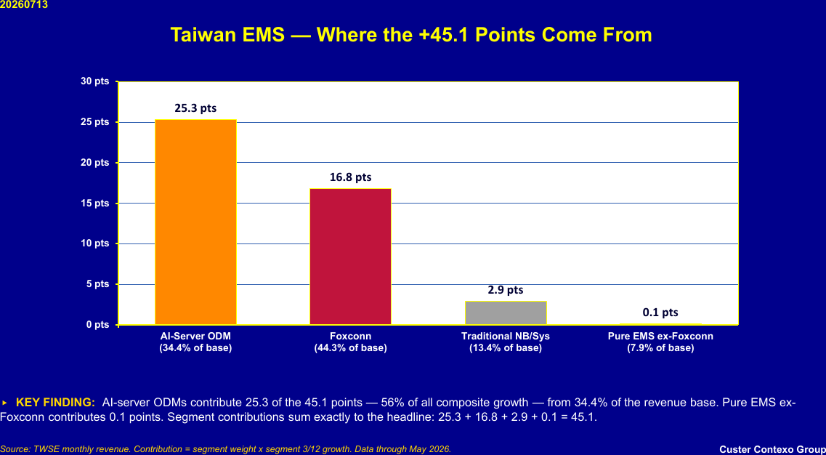
EMS, ODM & Assembly — A Recovery Led by Four Names
+45.1%
56%
1.2
Taiwan EMS composite (3/12)
of growth from 4 AI-server ODMs
Cicor H1 2026 book-to-bill (5th qtr >1)
ANALYST READ
DEMAND ▲
The Taiwan assembly composite reads like a broad recovery at +45.1% — its fastest in the cycle — and Europe corroborates with Cicor's fifth straight quarter of book-to-bill above one.
SUPPLY ▼
The breadth is an illusion: four AI-server ODMs supply 56% of the growth and their momentum peaked in January, so the pull is concentrated and decelerating at the margin.
NAVIGATE →
Anchor assembly commitments to the AI-mix winners, but stress-test volumes for the ODM deceleration; qualify India/ASEAN lines ahead of tariffs.
◆ CHART NOTE AI-server ODMs = 25.3 of the 45.1 pts (56%) — and their momentum already peaked in January (+90.3% → +73.6%).
TAKEAWAY The bottom is in for assembly — but four names carry it, and they are already past their fastest point.
Contexo Supply Chain Market Pulse · Weekly
custerconsulting.com · @joncustercontexo

Slide 7
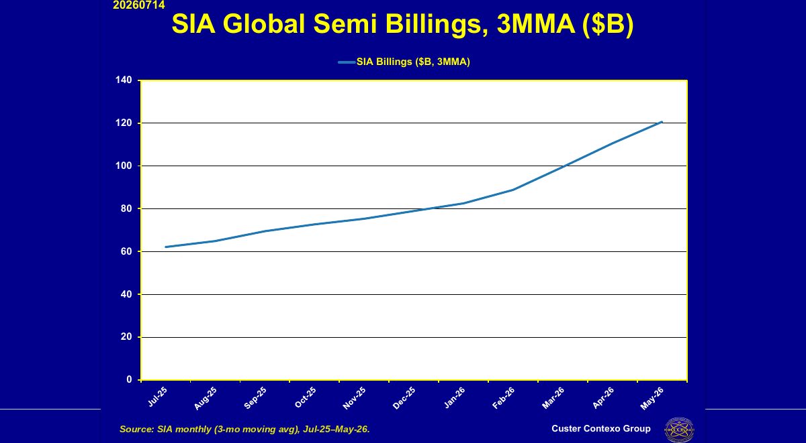
Semiconductors & Components — Record Billings, Narrow Base
$120.6B
~36%
>2
SIA billings, record 3-mo avg (May 2026)
Americas share, 2026F (WSTS) — 2nd, fastest
STMicro book-to-bill, comms (Q2 2026)
ANALYST READ
DEMAND ▲
The cycle is steepening: record billings, the Americas growing fastest on the AI build, and STMicro reporting book-to-bill near 2 (well above 2 in communications) — strong forward visibility.
SUPPLY ▼
The memory complex is the other face — SK Hynix posted an all-time record quarter at a 76% operating margin and DDR5 spot set new highs, so the constraint is allocation and cost, not demand.
NAVIGATE →
Lock multi-year logic, HBM and leading-edge allocation now; price memory-cost inflation into contracts before it migrates into your bill of materials.
◆ CHART NOTE The Americas is the fastest-growing billing region at ~36% of sales, second to Asia Pacific — SIA billings hit a record $120.6B (3-mo avg, May).
TAKEAWAY Semiconductors are the steepening core — record billings, but concentrated in AI and memory.
Contexo Supply Chain Market Pulse · Weekly
custerconsulting.com · @joncustercontexo

Slide 8
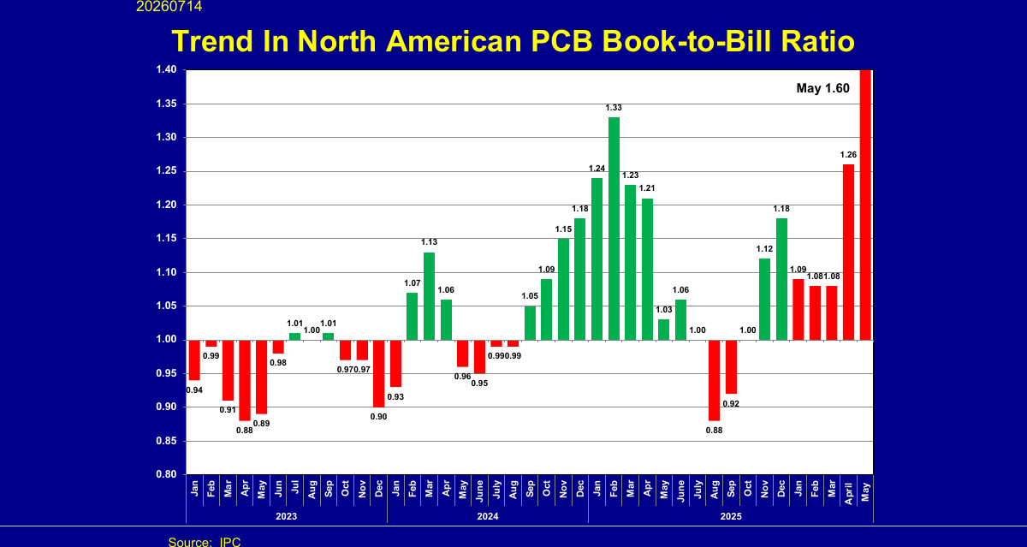
Printed Circuit Boards — The Map Moves to Southeast Asia
1.60
12.3%
+22.4%
NA PCB book-to-bill, May 2026 (GEA)
SE Asia share of global PCB, 2025 (TPCA)
Thailand 2025 output, $5.06B (TPCA)
ANALYST READ
DEMAND ▲
AI and advanced packaging drive high-layer, HDI and substrate demand; the NA book-to-bill at a cycle-high 1.60 in May 2026 confirms boards are pulled ahead of the components that populate them.
SUPPLY ▼
Capacity is relocating — Thailand +22.4% to $5.06B, Vietnam +33.9% to $4.15B — as fabricators run 'R&D at home, manufacturing overseas' to dodge tariff and concentration risk.
NAVIGATE →
Diversify high-layer capacity into SE Asia ahead of the tariff wave, pre-buy laminate and copper foil, and exit commodity-board exposure where oversupply sits.
◆ CHART NOTE NA book-to-bill hit a cycle-high 1.60 in May 2026; SE Asia is ~12.3% of global PCB value (2025) and rising fast.
TAKEAWAY The board recovery is real and relocating — SE Asia is where the new high-value capacity is going.
Contexo Supply Chain Market Pulse · Weekly
custerconsulting.com · @joncustercontexo

Slide 9

Electronic Materials — The Quiet Cost Squeeze
×4
Downstream
2027
DDR5 spot, Q4 2025 surge (TrendForce)
memory cost migration (2 qtrs)
glass-substrate volume ramp
Input-Cost Pressure Building Through the Chain (index, higher = tighter)
ANALYST READ
DEMAND ▲
Every board and package this cycle needs more memory, substrate, copper and specialty gas; the AI build pulls all of them at once.
SUPPLY ▼
The squeeze is forward-loaded: DDR5 spot up ~4× since Q4 2025, substrates tightening, and glass-substrate volume gated to 2027 (Absolics targets limited output in 2026) — cost, not supply, is the near-term risk.
NAVIGATE →
Hedge memory and copper exposure now, secure gas contracts near new fabs, and qualify a second substrate path against the 2027 glass timeline.
Source: Custer Contexo Group; Business Outlook. CCG Daily News, Jul 19–25 2026.
◆ CHART NOTE DDR5 spot roughly quadrupled in Q4 2025 and hit fresh record module highs in July — a cost shock migrating into PCs, handsets and autos.
TAKEAWAY Materials are where the margin gets taken — the memory cost shock is already in transit downstream.
Contexo Supply Chain Market Pulse · Weekly
custerconsulting.com · @joncustercontexo

Slide 10
Process Equipment — Front-Running the 2027 Ramp
Record
~60%
Adv. pkg
hyperscaler capex, 2026F (~$710B guided)
AI share of BESI system orders, H1 2026
the binding capacity constraint
Hyperscaler Capex (US$B) — Amazon, Microsoft, Alphabet, Meta Combined
ANALYST READ
DEMAND ▲
The capex supercycle is concentrated in advanced-packaging and hybrid-bonding tools; hyperscaler spending is the best forward read on demand two tiers down.
SUPPLY ▼
Back-end tool lead times are stretching and Western chokepoints keep leverage with a few suppliers, so equipment — not wafers — is the gate on 2027 capacity.
NAVIGATE →
Place equipment and packaging-line orders early against 2027 capacity; use hyperscaler capex guidance as your leading indicator for board and material commitments.
Source: Company filings and 2026 guidance — Alphabet, Amazon, Microsoft, Meta. CCG Daily News, Jul 19–25 2026.
◆ CHART NOTE Hyperscaler capex is the leading indicator for the entire electronics chain — it sets the 2027 packaging and PCB ramp.
TAKEAWAY Back-end equipment leads the cycle — hyperscaler capex is the dial to watch first.
Contexo Supply Chain Market Pulse · Weekly
custerconsulting.com · @joncustercontexo

Slide 11

Contexo PCB World Index — by Country
PCB Composite Index by Country (0–100, four-pillar market-health model)
READING THE BANDS
■ ≥ 55 Expansion
■ 50–55 Mild expansion
■ < 50 Contraction
Neutral = 50
57.6
USA — strongest market
44.2
Europe — weakest market
WHY IT MATTERS
The AI build lifts the US, Taiwan and ASEAN; legacy demand keeps Japan and Europe below neutral.
Source: Custer Contexo four-pillar model (Pulse 40% · Climate 30% · Friction 10% · Sentiment 20%); IPC/GEA, ISM, LME, company data. June 2026.
TAKEAWAY The board recovery is real but uneven by country — the US, Taiwan and ASEAN expand while Japan and Europe still lag the neutral line.
Contexo Supply Chain Market Pulse · Weekly
custerconsulting.com · @joncustercontexo

Slide 12
Raw Materials — Supply vs. Demand
Demand vs. Supply Index by Material (Demand > Supply = tightening)
×3
DDR5 spot price
Tight
Substrate & copper
$100+
Energy / Brent
Source: Custer Contexo Group; Business Outlook. 0–100 index; higher demand-over-supply gap = tighter market.
TAKEAWAY Memory and substrate are the tightest inputs and the clearest margin pressure into the second half.
Contexo Supply Chain Market Pulse · Weekly
custerconsulting.com · @joncustercontexo

Slide 13


SWOT for Executives
STRENGTHS
WEAKNESSES
• AI-infrastructure capex is a broad, supply-constrained pull up the whole chain (company filings, 2026)
• End demand is narrow — Q2 PCs fell for the first time this cycle on memory cost (IDC, 2026)
• The Americas is the fastest-growing semiconductor billing region at ~36% of sales (SIA/WSTS, 2026)
• Taiwan's +45.1% recovery rests on four AI-server ODMs (56% of growth), past peak (TPCA/Custer, 2026)
• European order books corroborate — Cicor's 5th straight quarter of book-to-bill above 1 (Cicor, 2026)
• Rising memory & substrate cost threatens margins before volume broadens
OPPORTUNITIES
THREATS
• High-layer PCB, IC substrate & advanced packaging capacity in SE Asia (TPCA, 2026)
• Energy-shock tail risk — Brent topped $100 on Jul 23, plus freight (OECD, Jun 2026)
• Memory up-cycle pricing power — SK Hynix record Q2 margin (SK Hynix, 2026)
• DDR5 spot up ~4× since Q4 2025 — a cost shock migrating into PCs, handsets & autos
• Trusted-connectivity & optical AI demand compounding across the chain
• A pause in AI capex would ripple straight down to boards and materials
Contexo Supply Chain Market Pulse · Weekly
custerconsulting.com · @joncustercontexo

Slide 14
Forecast — Directional Outlook
Whole-Market Pulse — Trend & 4-Week Outlook
Source: Custer Contexo Group. Points marked * are a directional outlook from momentum, not a guarantee.
TAKEAWAY Momentum points modestly higher — but the slope depends on whether demand broadens beyond the data-center thread.
Contexo Supply Chain Market Pulse · Weekly
custerconsulting.com · @joncustercontexo

Slide 15



Actionable Items by Job Function
CEOs & Sr VPs
Sales & Marketing
DO: Re-aim the multi-year footprint to advanced packaging, IC substrate and SE-Asia high-layer PCB.
DO: Concentrate on AI-server, datacenter and high-reliability accounts that can absorb memory-cost pass-through.
WHY: AI infrastructure is the one broad, supply-constrained pull — and it is relocating capacity to Southeast Asia.
WHY: Demand is voracious in AI and flat in consumer, so price power lives with the datacenter buyer.
WATCH: hyperscaler capex guidance and the AI-server ODM momentum gauge.
WATCH: DRAM/HBM pricing and datacenter order lead times.
Finance & M&A
Procurement
DO: Hedge memory and copper exposure; target EMS/PCB consolidation in SE Asia.
DO: Dual-source boards into Thailand/Vietnam ahead of tariffs; lock multi-year memory & substrate.
WHY: Memory pricing power has shifted to suppliers and value is migrating to substrate and packaging.
WHY: Tariff and concentration risk is pushing the map to SE Asia while substrate mass-production is gated to 2027.
WATCH: DDR5 contract prices and SE-Asia capacity M&A multiples.
WATCH: Section 301 tariff scope and substrate/glass lead times.
Contexo Supply Chain Market Pulse · Weekly
custerconsulting.com · @joncustercontexo

Slide 16
Sources — Daily News & Business Outlook (APA)
• TPCA. (2026, July 20). Southeast Asia ~12.3% of global PCB output value (2025); Thailand +22.4% to US$5.06B, Vietnam +33.9% to US$4.15B. Taiwan Printed Circuit Association.
• SK Hynix. (2026, July 28). DRAM/NAND up-cycle drove an all-time record quarter at a 76% operating margin; DDR5 spot roughly quadrupled from Q4 2025. SK hynix.
• Custer Contexo Group. (2026, July). Taiwan Top-13 EMS composite +45.1% (3/12); AI-server ODMs = 25.3 of 45.1 pts. Business Outlook (slides 8, 11, 12).
• Gartner. (2026, July 20). AI platforms and models market forecast at US$64.25B in 2026, up 63.4% from US$39.31B. Gartner.
• Cicor Group. (2026, July). First-half book-to-bill of 1.2 — fifth consecutive quarter above one. Cicor.
• IDC. (2026, July). Global Q2 PC shipments fell 4.9% to 68.2M units — the first decline this cycle as memory cost reaches buyers. IDC.
• Global Electronics Association. (2026, June 30). North American PCB book-to-bill at a cycle-high 1.60 in May 2026; the May report incorporated updated survey methodology. GEA (formerly IPC).
• STMicroelectronics. (2026, July 23). Q2 bookings reported at book-to-bill close to 2 overall, significantly above 2 in Communication Equipment & Computer Peripherals. Q2 2026 earnings call.
• OECD. (2026, June). Base-case global growth 2.8% (2026) and 3.1% (2027); prolonged energy-shock scenario cuts 0.7 and 1.3 pts from growth and adds 0.4 and 1.3 pts to inflation. OECD Economic Outlook Vol. 2026/1.
• SIA / WSTS. (2026). Record US$120.6B three-month average billings (May 2026, released July 6); Americas ~36% of sales — fastest-growing region, second to Asia Pacific. SIA; WSTS June 2026 forecast.
Compiled from the Custer Contexo Group Daily News (July 19–25, 2026) and the CCG Business Outlook weekly chart set. In-text APA references appear in the written briefing.
Contexo Supply Chain Market Pulse · Weekly
custerconsulting.com · @joncustercontexo

Slide 17
Custer Contexo Group
Contexo Supply Chain Market Pulse — Electronics Supply Chain
Week of July 25, 2026 · Daily News July 19–25
Weekly Supply-Chain Intelligence | For Those That Need To Know
custerconsulting.com · YouTube @joncustercontexo

